Slide 1
IT-
Workgroup

Slide 2
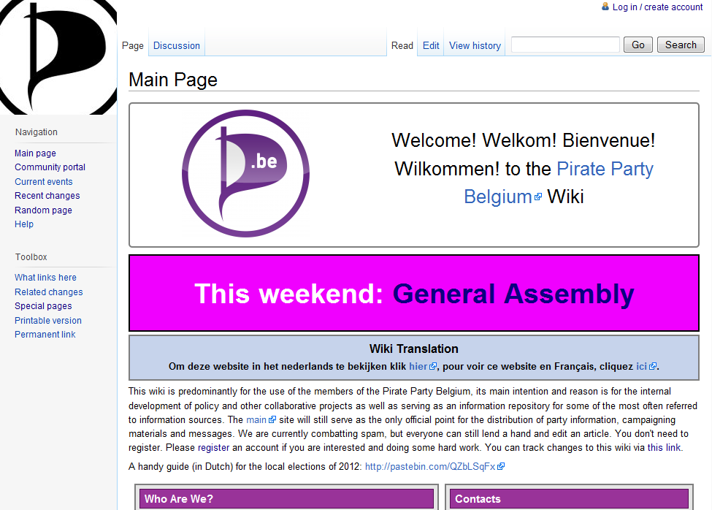

Slide 3
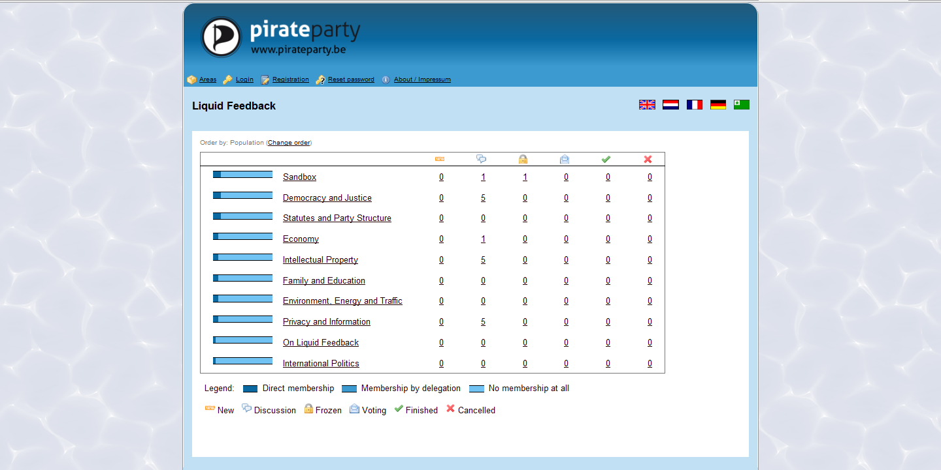

Slide 4
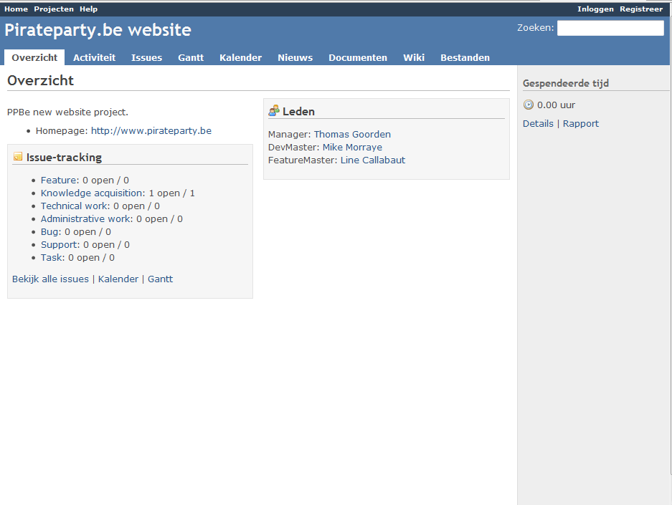

Slide 5
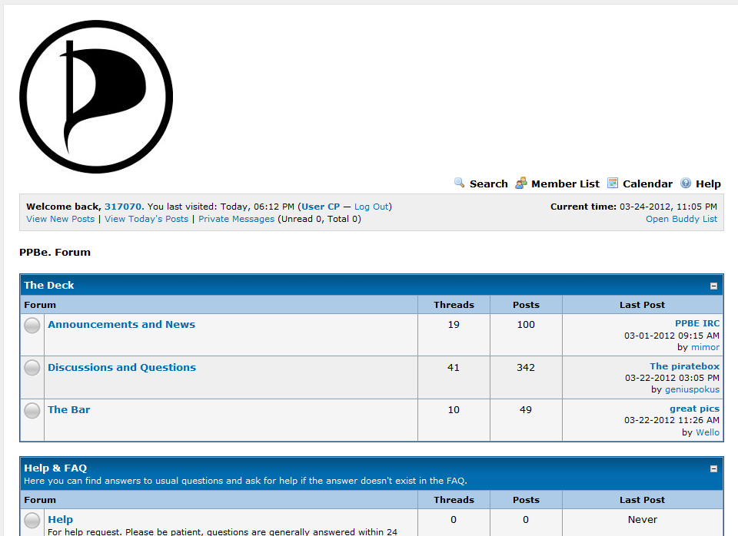

Slide 6
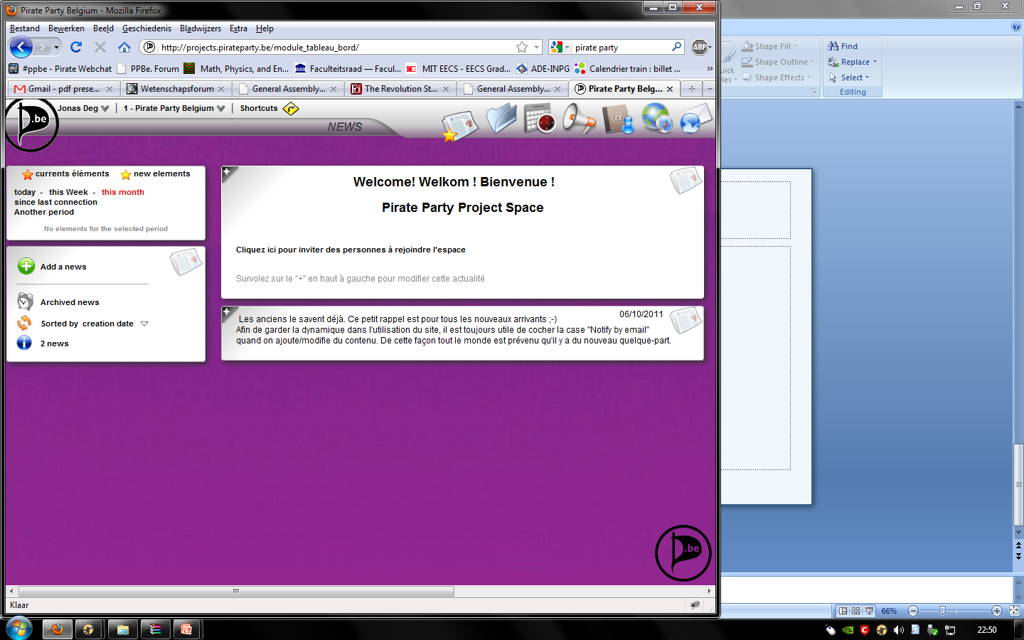

Slide 7
We is looking for:
People with some experience in web-IT
think: Linux, Apache, ...
People with a have-you-tried-turning-it-off-and-on-again-mentality
Contact: itworkgroup@pirateparty.be

Slide 8
We is looking for:
People to occasionally translate from and to EN-NL-FR-DE
Contact: itworkgroup@pirateparty.be

Slide 9
We is looking for:
People who know HTML-CSS and a have a feeling for aesthetics
Contact: itworkgroup@pirateparty.be

