Slide 1
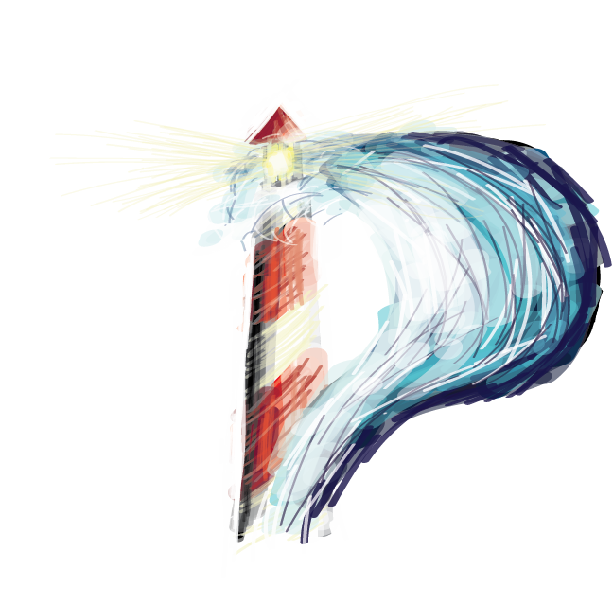
Liquid
Feedback

Slide 2
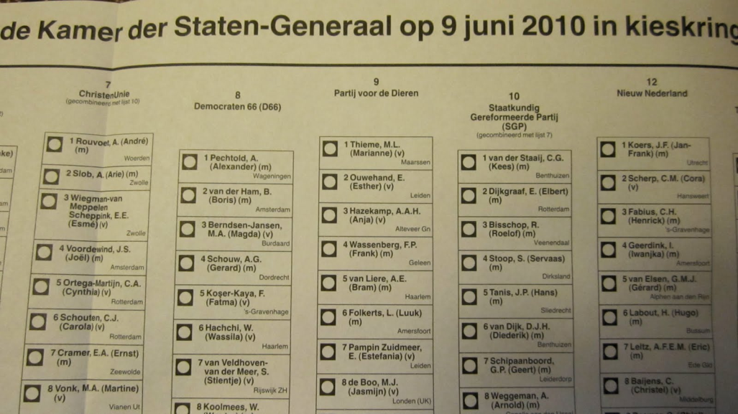

Slide 3
Democracy
Secret Ballot Voting:
Introduced in 1856 in Australia
Introduced in 1877 in Belgium

Slide 5
1877

Slide 6
Modern Democracy barely changed in over 145 years

Slide 7
Democracy
Particracy
Pillarisation
Nepotism
Clientilism

Slide 8
Common problems
Not everyone has the time
Representatives have a whole pack of objectives
Delegation is irreversible
Voting rarely expresses real preference

Slide 9
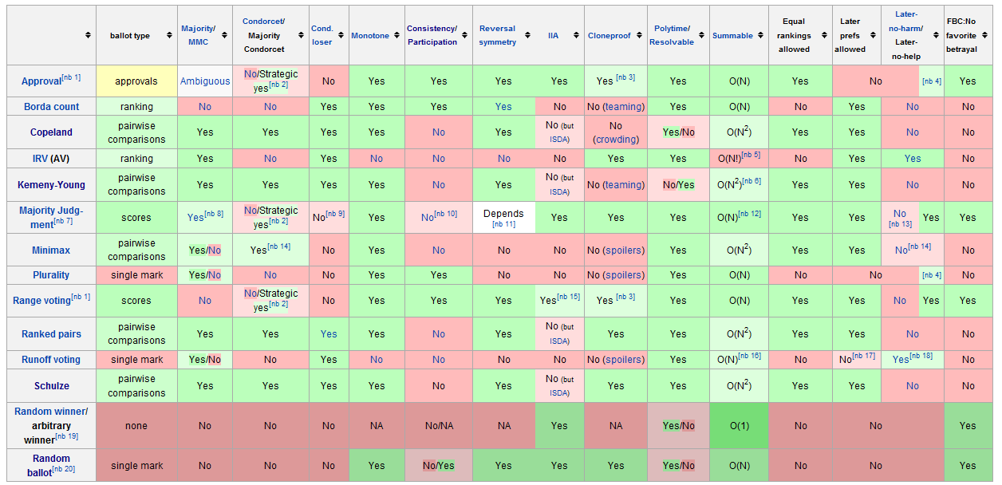
Research
A lot of research has been done on voting systems in the meantime

Slide 10
But...
it has never been used before?

Slide 11
That‘s where we come in

Slide 12
Liquid
Feedback

Slide 13
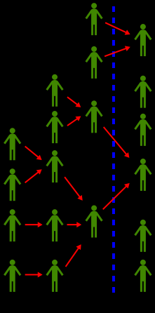
Liquid Feedback
Direct democracy
Representative democracy

Slide 14
Everyone 1 Vote
You can represent yourself in all issues
(direct democracy)
You can delegate your vote to another member
(representative democracy)
Or something inbetween

Slide 15
How does it work
several themes
1 theme | Several issues
 | 1 issue | Several initiatives
Everyone can post new initiatives or address new issues

Slide 16
5 phases
Phase 1: someone addressed a new issue and posted an initiative
-A quorum is needed in order to address the issue as a party
-A minimal number of people need to think this is an important issue

Slide 17
5 phases
The issue got accepted
Discussion phase starts

Slide 18
5 phases
Phase 2: Discussion phase
Other initiatives can be proposed to solve this issue
Suggestions and amandments to existing initiatives can be made

Slide 19
5 phases
After a fixed period of time the issue gets frozen
This is the final wording
New quorum needed: has the discussion been fruitful?

Slide 20
5 phases
After a fixed period of time the voting begins
Which initiatives (plural) are approved?
Which initiative is the most preferred?

Slide 21
5 phases
After voting is finished:
the result is archived on the site
The approved initiatives are adopted by the party

Slide 22
How does it work?

Slide 23
Get your hands dirty
1) Open your laptop
2) If you already have an account:
-> go to lqfb.pirateparty.be
If you don’t have an account yet:
-> mail to lqfb@lqfb.pirateparty.be

Slide 24
Questions?

Slide 25
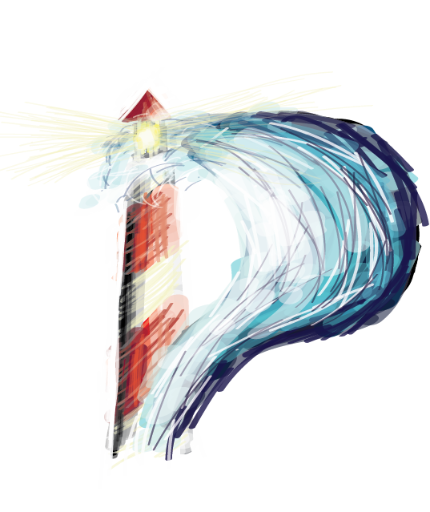

Slide 26
Transit to 2.0?
No French translation
but
Support for multiple organizational units (sub divisions)
A programming interface with read and write access
Improved implementation of Schulze method
An integrated notification system
Integration of Etherpad Lite
Wiki format for suggestions and comments
Purified user interface
Removed auto-reject and vote later to simplify the system

Slide 27
Thanks

